Slide 1
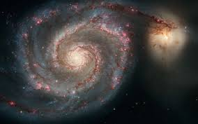

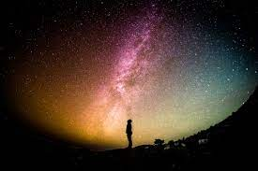
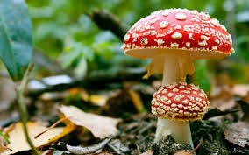

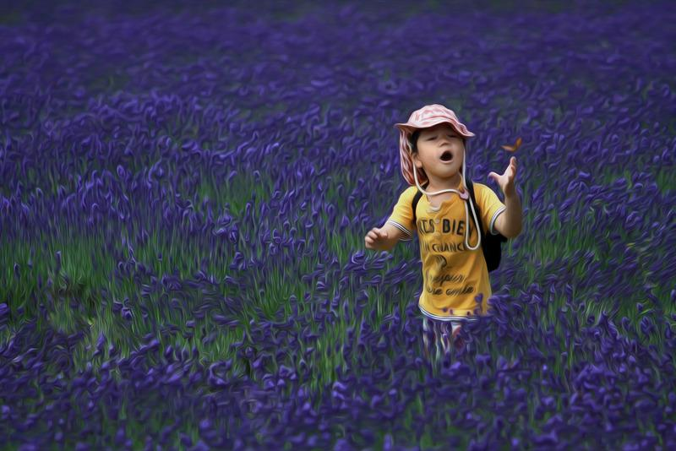
Spark curiosity and build learner autonomy with interactive video

Slide 2

Play Posit Canvas
Questions related to Playposit installation, please email support@ccctechconnect.org

Slide 3
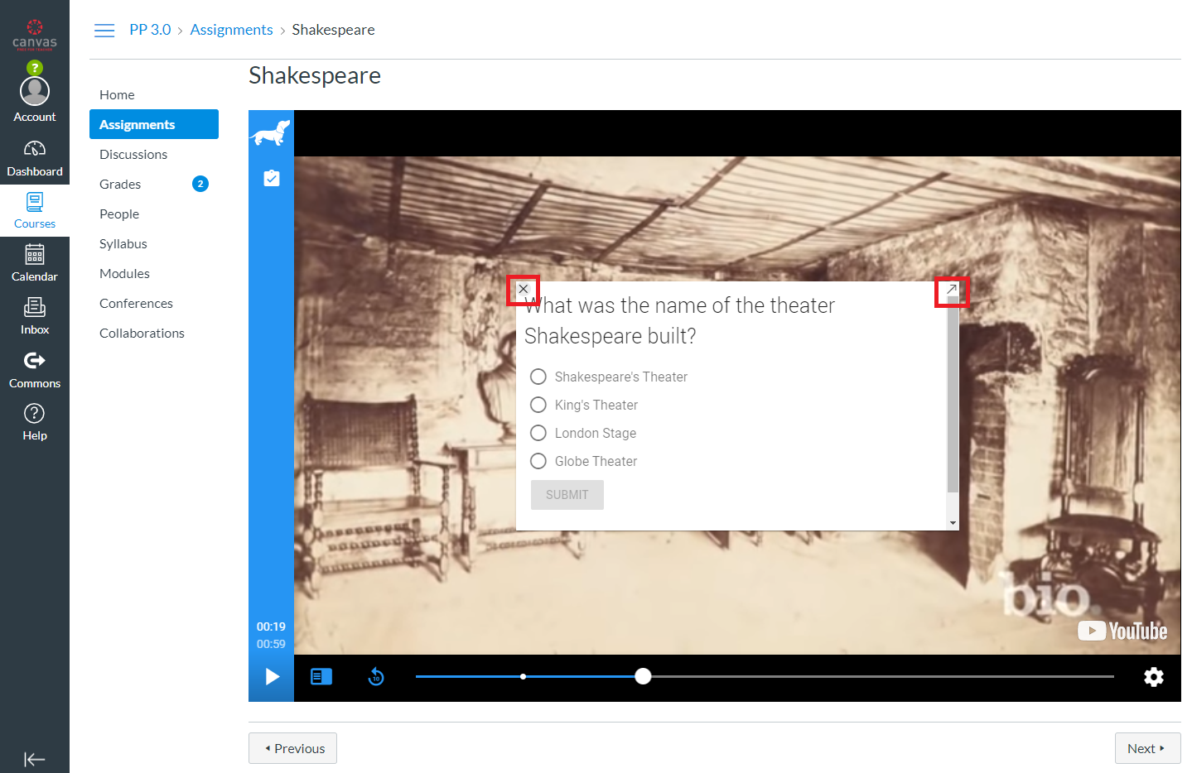
Shakespeare Example

Slide 4
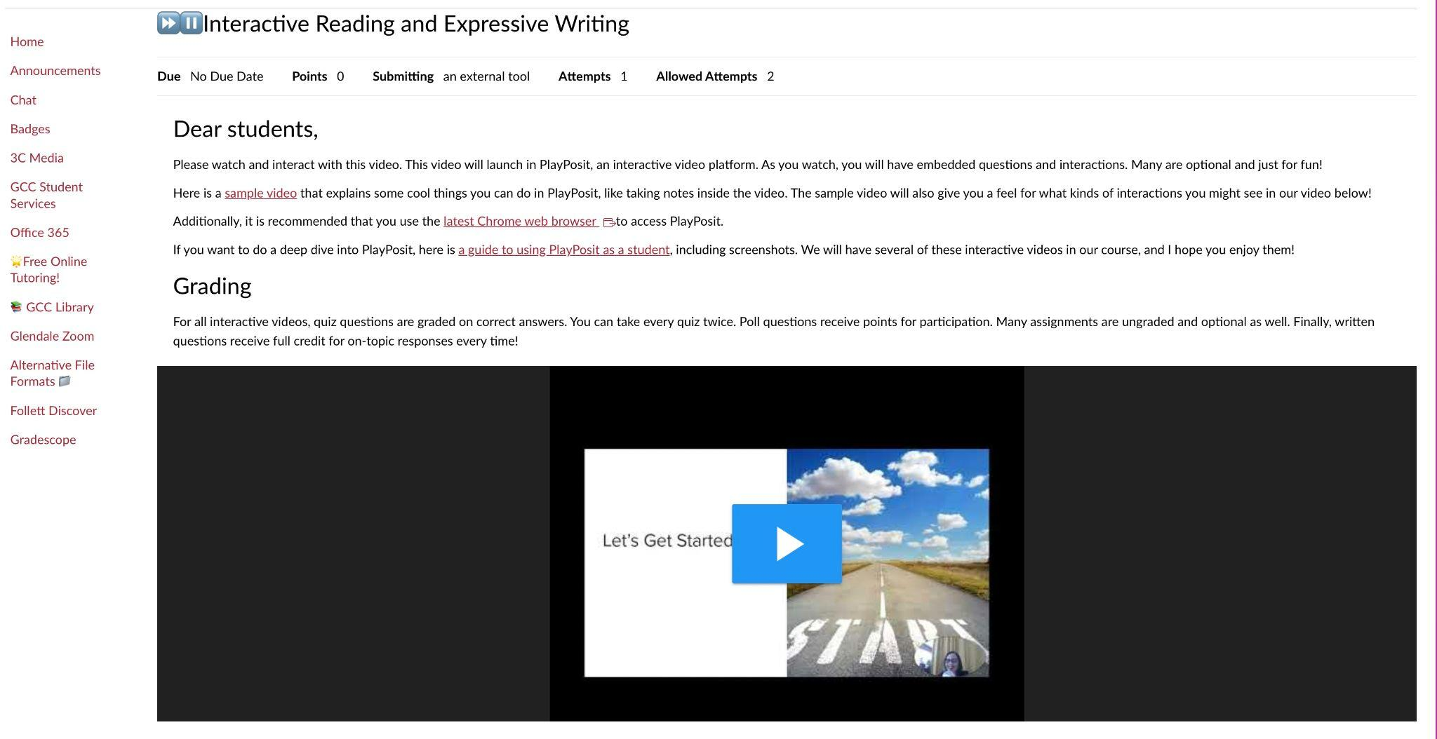
Interactive Video Assignment Student View

Slide 5
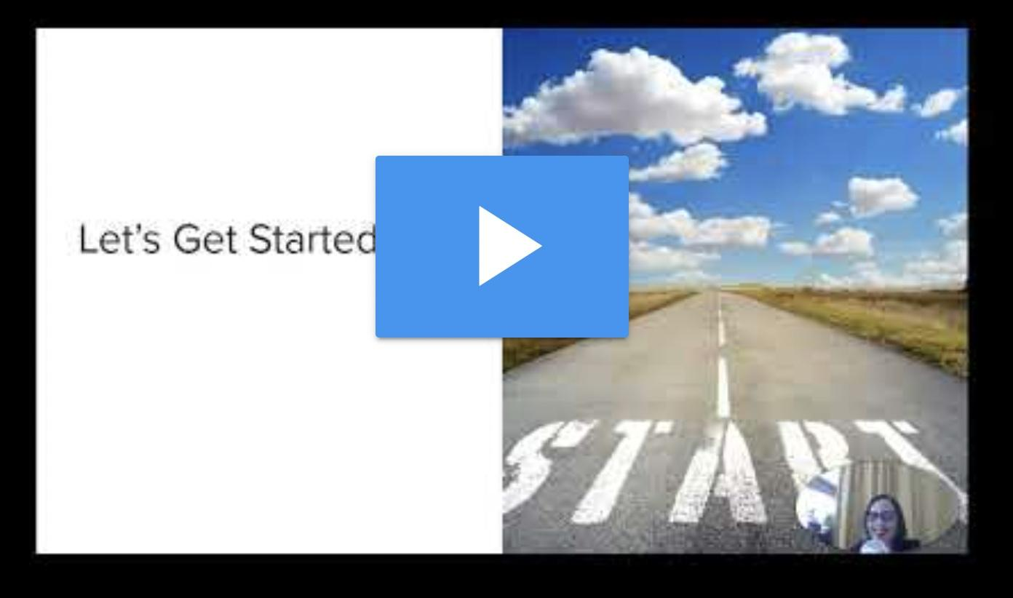
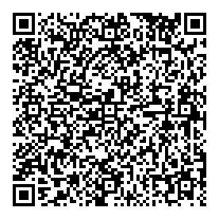

Interactive Reading And Expressive Writing Interactive video: https://tiny.one/readingwriting
Instructor Created Video Julie Gamberg
@juliegamberg

Slide 6
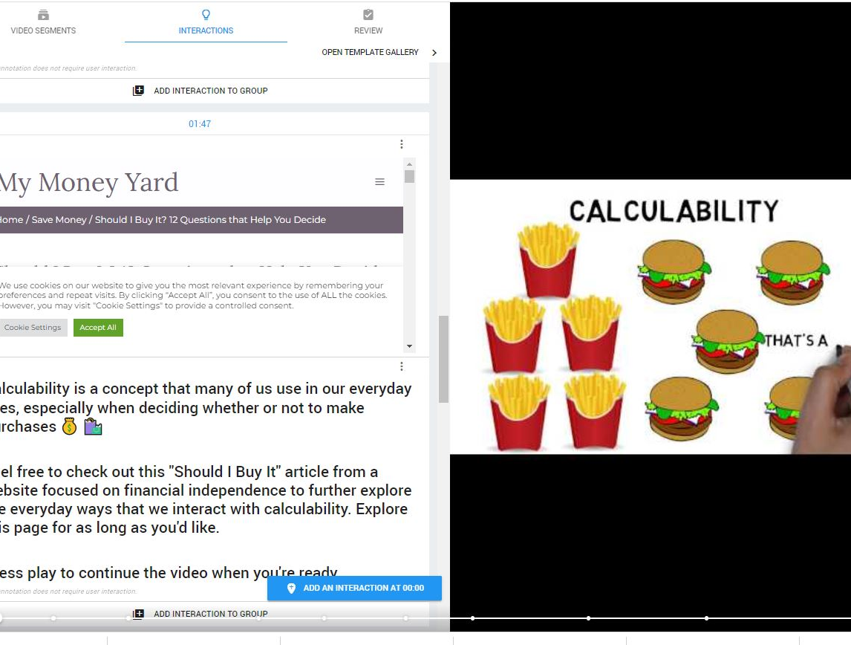
Interactive Video Instructor Editing View

Slide 7
PlayPosit Goody Bag Courtesy of Brady Venables, playposit instructional designer
https://www.playposit.com/playlist/j5j3rc4mvjrv
Brady Venables, instructional designer with PlayPosit, has spent years exploring, implementing, and refining instructional practices that incorporate technology. Her passion for helping instructors uncover edtech practices and solutions that enhance the teacher-student relationship led her from the classroom to district level administration and eventually to PlayPosit. She is passionate about both helping instructors elevate their teaching practices with interactive video and helping leadership align PlayPosit to greater institutional goals and outcomes.

Slide 8

Curiosity & Wonder

Slide 9
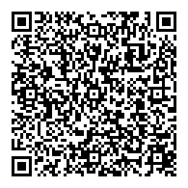
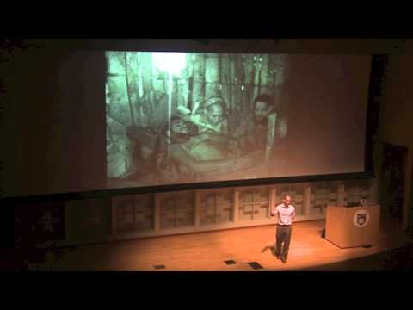
The End of Wonder in the
Age of Whatever
Interactive video: https://tinyurl.com/endofwonder
Unmodified Video
Michael Wesch
https://www.k-state.edu
/sasw/faculty/wesch.html

Slide 10
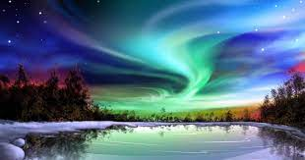
Circle of Wonder
Wonder
Awe
Scholarship
Curiosity
Critical Discourse
Questions

Slide 11
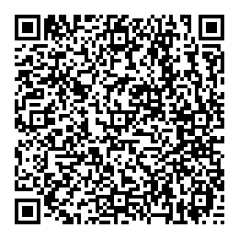
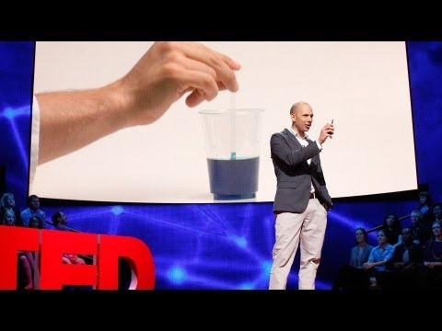
3 Rules to Spark Learning Interactive Video: https://tiny.one/3rules
Unmodified Video
Ramsey Musallam
https://www.cyclesoflearning.com/

Slide 12

Video
How might you grow with video?
What could that shift for you and your students?

Slide 13
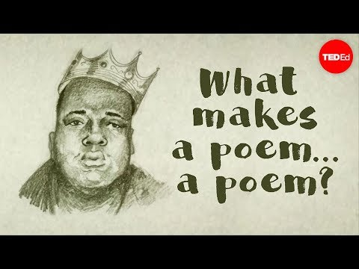
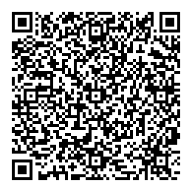
What Makes a Poem …
A poem? Interactive video: https://tiny.one/makesapoem
Unmodified Video
Melissa Kovacs Https://ed.ted.com/lessons
/what-makes-a-poem-a-poem-melissa-kovacs

Slide 14
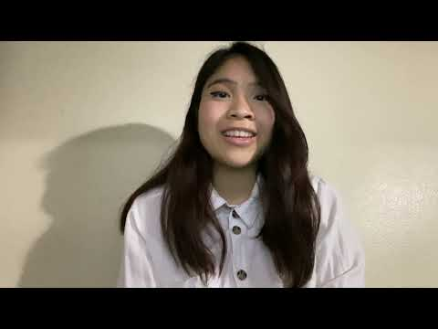
Student Reflections
What Makes a Poem …
A poem? Interactive video:
https://tiny.one/makesapoem

Slide 15

Q&A

Slide 16
Thank you for joining me! Please stay in touch! @juliegamberg

