Slide 1



Housekeeping and Agenda Overview
Tech Support
Technical support is available
Closed Captioning
Click the Closed Caption (CC) tab to read live captions
Q&A
You will be muted with your camera’s off during the entire webinar. Click the Q&A tab to enter questions for the presenters and read their responses. We will do our best to answer as many questions before the end of this session. Questions we are unable to answer will be addressed post-event in the coming weeks.
Recording
This session will be recorded.

Slide 2
Accessibility in Online Learning
February 3, 2026

Slide 3
Accessibility Center
Dawn Okinaka- Accessibility Director CCC Accessibility Center
CCC Technology Center

Slide 4
CCC Accessibility Center
CCC Chancellor’s Office Grant
Systemwide Infrastructure Grant (SIG)
What we are funded to do
Funding
Guidance
504 (HTCTU) funding from: Educational and Support Services (ESS)
Training
CCC Technology Center
Tools
508 funding from: Information Security, Technology and Innovation (ISTI)
Butte College
Resources
4

Slide 5
Other Training by CCCAC
Over 90 self-paced courses
8 One-hour webinars
ACMM in person training
Office hours on selected topics
Annual all-day workshop
Conference/ Other
5

Slide 6
Accessibility Capability Maturity Model
Seven Goals with 89 Milestones
Governance and Strategic Planning
Educational Materials and Technology
Websites and Applications
Digital Content
ICT Procurement and Adoption
Training
Culture
Assess
/reassess
Plan
Implement
6

Slide 7



ACMM Participants Cohorts 1-3
Butte-Glenn CCD
Grossmont-Cuyamaca CCD
Cabrillo CCD Citrus CCD Clovis College Compton CCD Desert CCD
Hartnell CCD
Kern CCD
Los Angeles CCD
Los Rios CCD
Marin CCD
Mendocino-Lake CCD
Merced CCD
MiraCosta CCD | Monterey Peninsula | Ohlone CCD | Palomar CCD | Pasadena Area CCD | Rancho Santiago CCD | Redwoods CCD
San Diego | San Mateo | Santa Barbara | Siskiyous Joint | Southwestern | South Orange | Ventura
CCD | CCD | CCD | CCD | CCD | County CCD | County CCD
 |  | Victor Valley CCD | West Kern CCD | West Valley-
CCD
Mission CCD
7

Slide 8
Contact Us/Community Engagement
Email
accessibility@ccctechcenter.org (General email)
acmm@ccctechcenter.org (ACMM-specific)
Website
cccaccessibility.org
Vision Resource Center
Accessibility Help Desk
LinkedIn
CCC Accessibility Center
Listservs
CCC Accessibility Center, Alternate Media, CCC Web Accessibility, LD Mailing list, DEAF Mailing list and C4A2
8

Slide 9
ASCCC
As the official voice of California community college faculty in academic and professional matters, the Academic Senate for California Community Colleges (ASCCC) is committed to equity, student learning and student success. The Academic Senate for California Community Colleges acts to empower faculty to engage in local and statewide dialog and take-action for continued improvement of teaching, learning, and faculty participation in
governance.

Slide 10

AI and Academia 2026: Navigating the Future
Event Dates
Thursday March 19, 2026, 1pm - Saturday March 21, 2026, 12:15pm
In partnership with the California Community Colleges Chancellor's Office, the Academic Senate for California Community Colleges is pleased to announce AI and Academia 2026: Navigating the Future.
This institute will center:
discipline-grounded practices, nuanced conversations, and actionable solutions for teaching and learning
10

Slide 11
AI & Pedagogy Brown Bag Office Hour with Online Education Committee
Event Dates
Thursday, Feb 5, 2026, 11am - 12pm
Do you have questions and/or curiosity about AI and teaching strategies, class policies, student or instructor use of AI tools, or any other topic around AI and pedagogy?
Join this office hour to ask your questions, bounce your ideas off attendees, or even just simply listen to what other faculty have to share/ask.
Feel free to enjoy your snack/beverage/lunch with us while you attend.
11

Slide 12

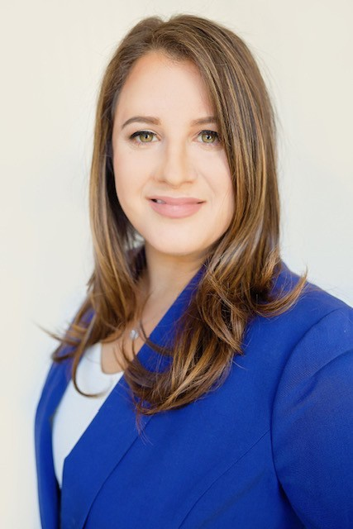
ADA Title II Updates
Elli Constantin, M. Ed.
Special AI Advisor for Accessibility, The Digital Innovation Transformation and
Equity Center
Distance Education Director, Cypress College econstantin@cypresscollege.edu

Slide 13

Agenda
Overview
What has not changed
What’s new
Key focus areas and solutions

Slide 14

ADA Title II (Quick Overview)
What is ADA Title II?
Applies to public colleges and universities. ADA Title II:
Equal access to programs, services, and activities
Including online courses, websites, videos, apps, and digital tools
Reinforces that accessibility is about equitable access, not accommodations paperwork
Responsibility is shared institutionally
Effective April 24, 2026
This applies:
Whether or not a student with a disability is enrolled
Across instruction, support services, and technology
Bottom line: Digital access is a baseline expectation, not a special accommodation.

Slide 15



What Has NOT Changed
Let’s start with what is still the same.
Most requirements are not new.
They align with WCAG 2.1 AA, which we have already been working toward.
Section 508
We are still expected to:
Provide captions for videos
Create screen reader–compatible content
Use alt text for meaningful images
Design content that follows POUR:
Perceivable
Operable
Understandable
Robust
Bottom line: These updates reinforce and clarify what we’ve already been doing.

Slide 16
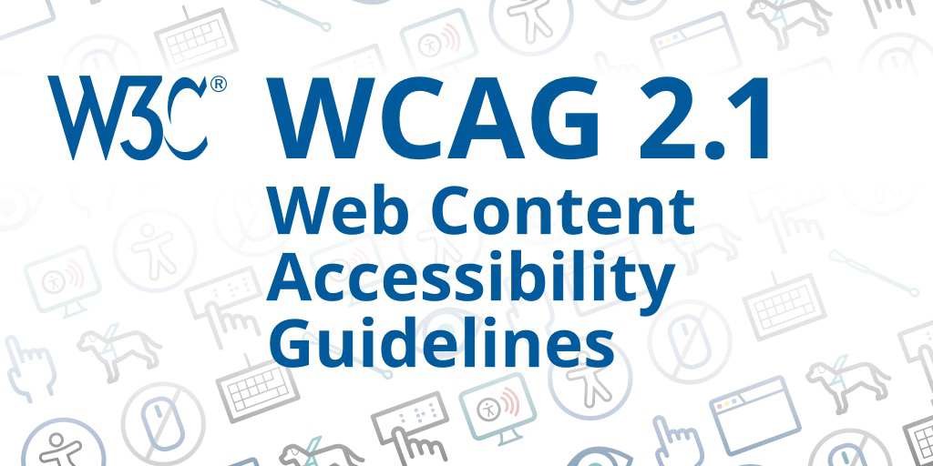
What’s New
What’s new is clarity and scope
Clear Adherence to WCAG 2.1 AA
WCAG 2.1 AA is now explicitly named
as the required standard
Prior to the update a WCAG was expected but not clearly named
Digital content is explicitly included
Clearer scope
Accessibility applies across the digital environment
This Photo by Unknown Author is licensed under CC BY-SA-NC

Slide 17


Expanded Focus on Digital Content
Third- party content
Social media
Mobile Access
Audio Descriptions
Instructionally relevant content
OER Materials
Videos, posts
Phones
Vendor, publisher materials, websites
Content linked to social media
Tablets, mobile devices
All videos
Translation for Faculty:
If you choose it, assign it, upload it, or link to it - accessibility matters.

Slide 18


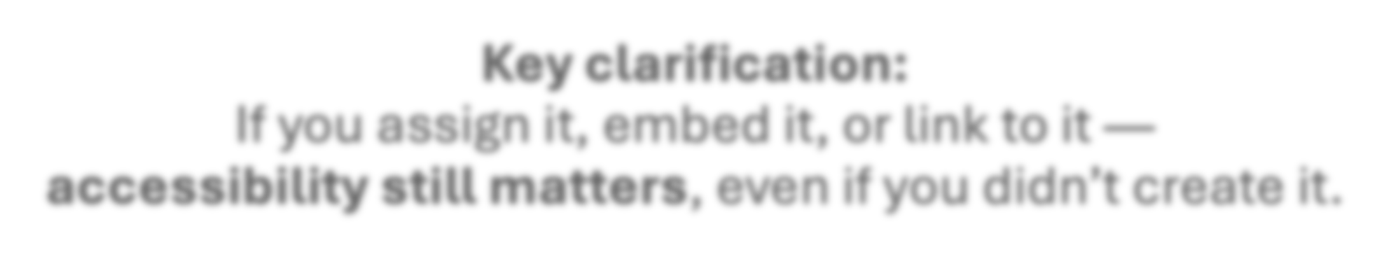



Focus Area #1: Third-Party Content
Key clarification:
If you assign it, embed it, or link to it —
accessibility still matters, even if you didn’t create it.
This includes:
OER textbooks
Publisher material
PDFs found online
Shared Google Docs
Websites

Slide 19
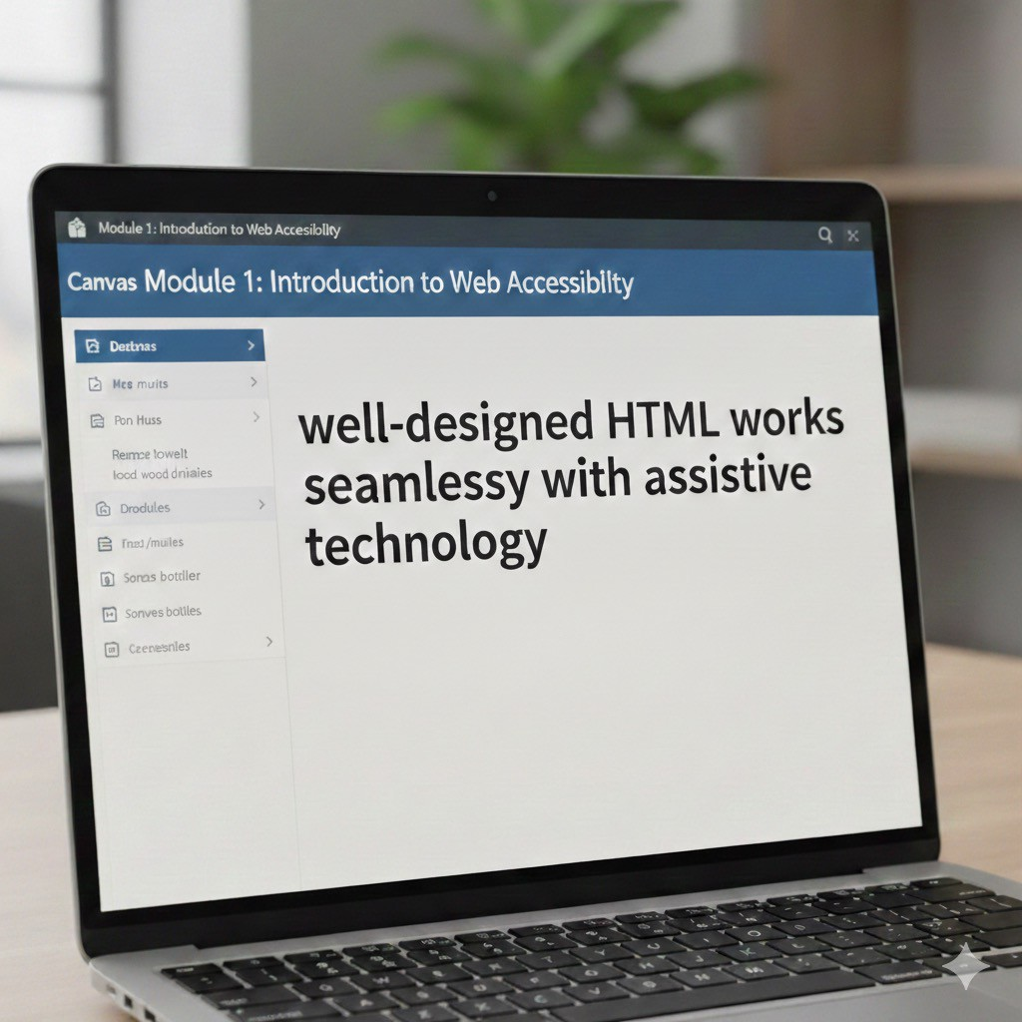

Solution: Convert to Accessible HTML (Using AI)
Best practice:
Convert third-party content into Canvas HTML pages when possible.
HTML:
Works better with screen readers
Scales on mobile
Is easier to update
Is more accessible than PDFs
AI Prompt:
Convert the following content into WCAG 2.1 AA–compliant HTML
for use in Canvas.
Format the content so it is clear, readable, and accessible for students using assistive technology.
Image of a laptop displaying web accessibility text Note. Generated with Gemini, by Google, January 14, 2026 (https://gemini.google.com/).

Slide 20
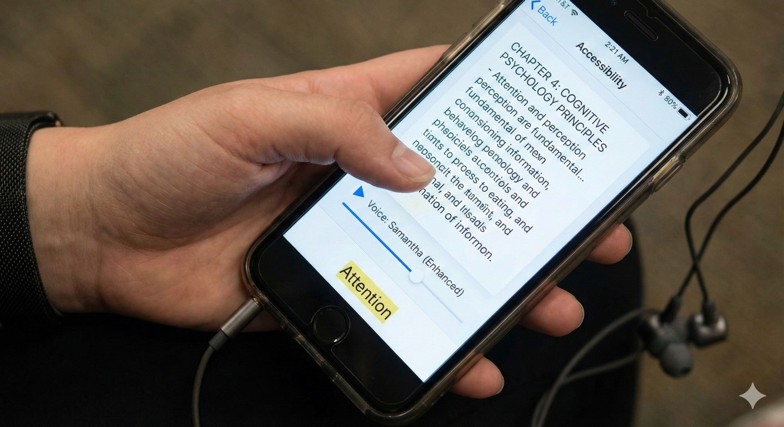

Focus Area #2: Mobile Access
Digital content must be usable on:
Phones
Tablets
Assistive technology on mobile devices
This includes:
Canvas pages
Embedded tools
Linked content
Videos
OER materials
Student using screen reader software. Generated by Google Gemini, January 14, 2026.
Mobile access is no longer optional.

Slide 21



Solutions for Mobile:
Check mobile:
Open the Canvas Student App
View your content on your phone
Ask yourself:
Is it easy to scroll and read?
Does the content resize well?
Do links and media work as expected?
Prompt AI for Mobile-Friendly Content:
AI Prompt: Review and revise this content to be mobile-friendly and WCAG 2.1 AA–compliant
Note:
This process is often much easier when content is in HTML
rather than PDFs or Word files.

Slide 22
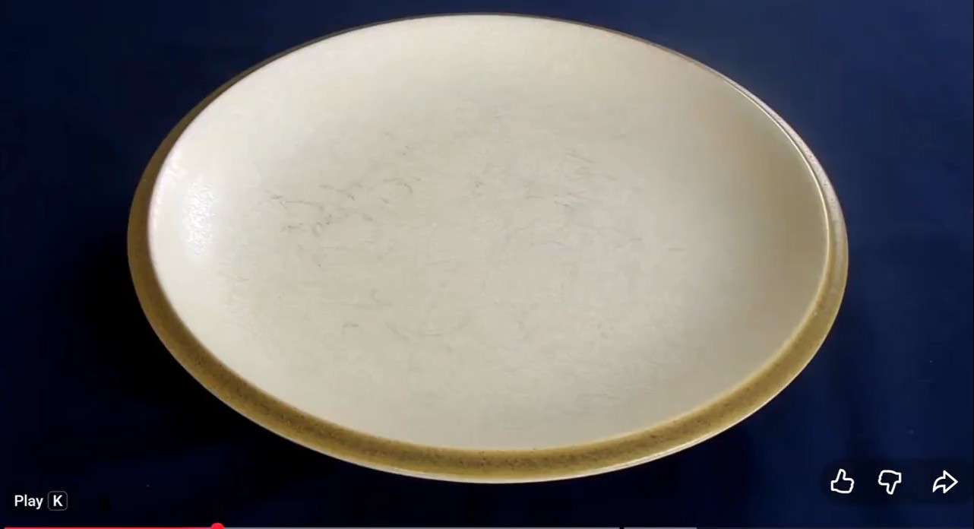

Focus Area #3: Audio Descriptions
Science Experiment Video
Audio descriptions explain visual information
when visuals are needed for understanding.
Examples:
Demonstrations
On-screen steps
Graphs or charts
Visual instructions
Question: If you closed your eyes, what would you miss?
They are not about describing everything. They focus on what students need to learn.

Slide 23
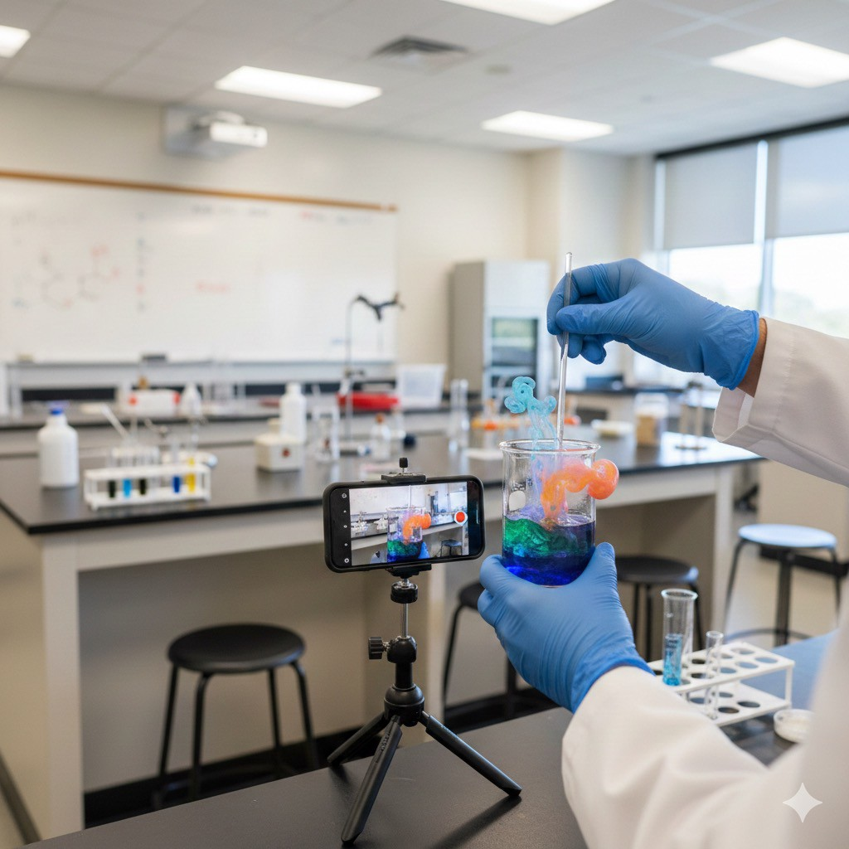

Solution 1: Narrate as You Teach (Best Option)
Say what you are doing as you do it.
Examples:
“I’m clicking on the Assignments tab.”
“This graph shows enrollment increasing from 2020 to 2024.” “Notice the highlighted section on the right.”
“Now, I am adding seven drops of green food dye.”
Hands of an instructor conducting a lab experiment for an online class. From College instructor’s hands conducting a chemistry experiment on camera in a lab, by Gemini, 2026, Google. Generated January 14, 2026.
If you narrate naturally, you may not need anything extra.

Slide 24


Solution 2: Use AI to Draft Text Descriptions
(With Oversight)
Text Descriptions Are Compliant (What the Law Says)
When platforms do not support built-in audio descriptions, a text-based description is allowed and compliant.
WCAG 2.1 – Success Criterion 1.2.3 states:
“An audio description OR a media alternative (text) is provided for prerecorded video-only and prerecorded audio-video media.”
WCAG 2.1, SC 1.2.3 – Audio Description or Media Alternative (Prerecorded), W3C https://www.w3.org/TR/WCAG21/ - audio-description-or-media-alternative-prerecorded
Prompt AI for Audio Descriptions:
Create a text-based audio description for the following video: [insert video link or title here]. Describe only visuals that are instructionally relevant to student learning. Do not describe decorative, background, or non-essential visual elements. Focus on actions, steps, diagrams, on-screen text, and visual changes that support understanding of the learning goal. Use the following learning context to guide what is included: [brief explanation of the learning goal or objective].
Next:
Always check the transcript
Paste the transcript under the video (expander) or linked
Remember: only the instructionally relevant parts without narration!!

Slide 25

Resources and Training
Trainings:
CVC@ONE- Creating Accessible Course Content (CACC)
WebAim
CCC Accessibility Center
FERPA compliant AI Platforms:
PlayLabAI:
Universal Access Bot
Joshua
Comply Bot

Slide 26
Thank you for attending and please complete the survey!

